Slide 1

Traduciendo Culturas Perú / Translating Cultures Peru
The complex role of indigenous translators and interpreters in Peru
Luis Andrade
Pontificia Universidad Católica del Perú

Slide 2
Focus on the trainees’ role
For the first time the Peruvian state assumes the responsibility of running a training program for translators and interpreters in indigenous languages.
251 speakers of 35 indigenous languages and Spanish have been trained so far.
This figure includes individuals of very different professional profiles.
Few of them see themselves only as translators or interpreters.
Notes:
Among the Andean countries, this is the first “translation policy” as such that is devoted to indigenous peoples. Therefore the need to document and analyse the initiative.
And we wanted to take into account the perceptions, experiences and discourses of the trainees.
These trainees include speakers of different varieties of Quechua.
As we will see, they have an auto-perception of delegates or cultural ambassadors in the first place.

Slide 3
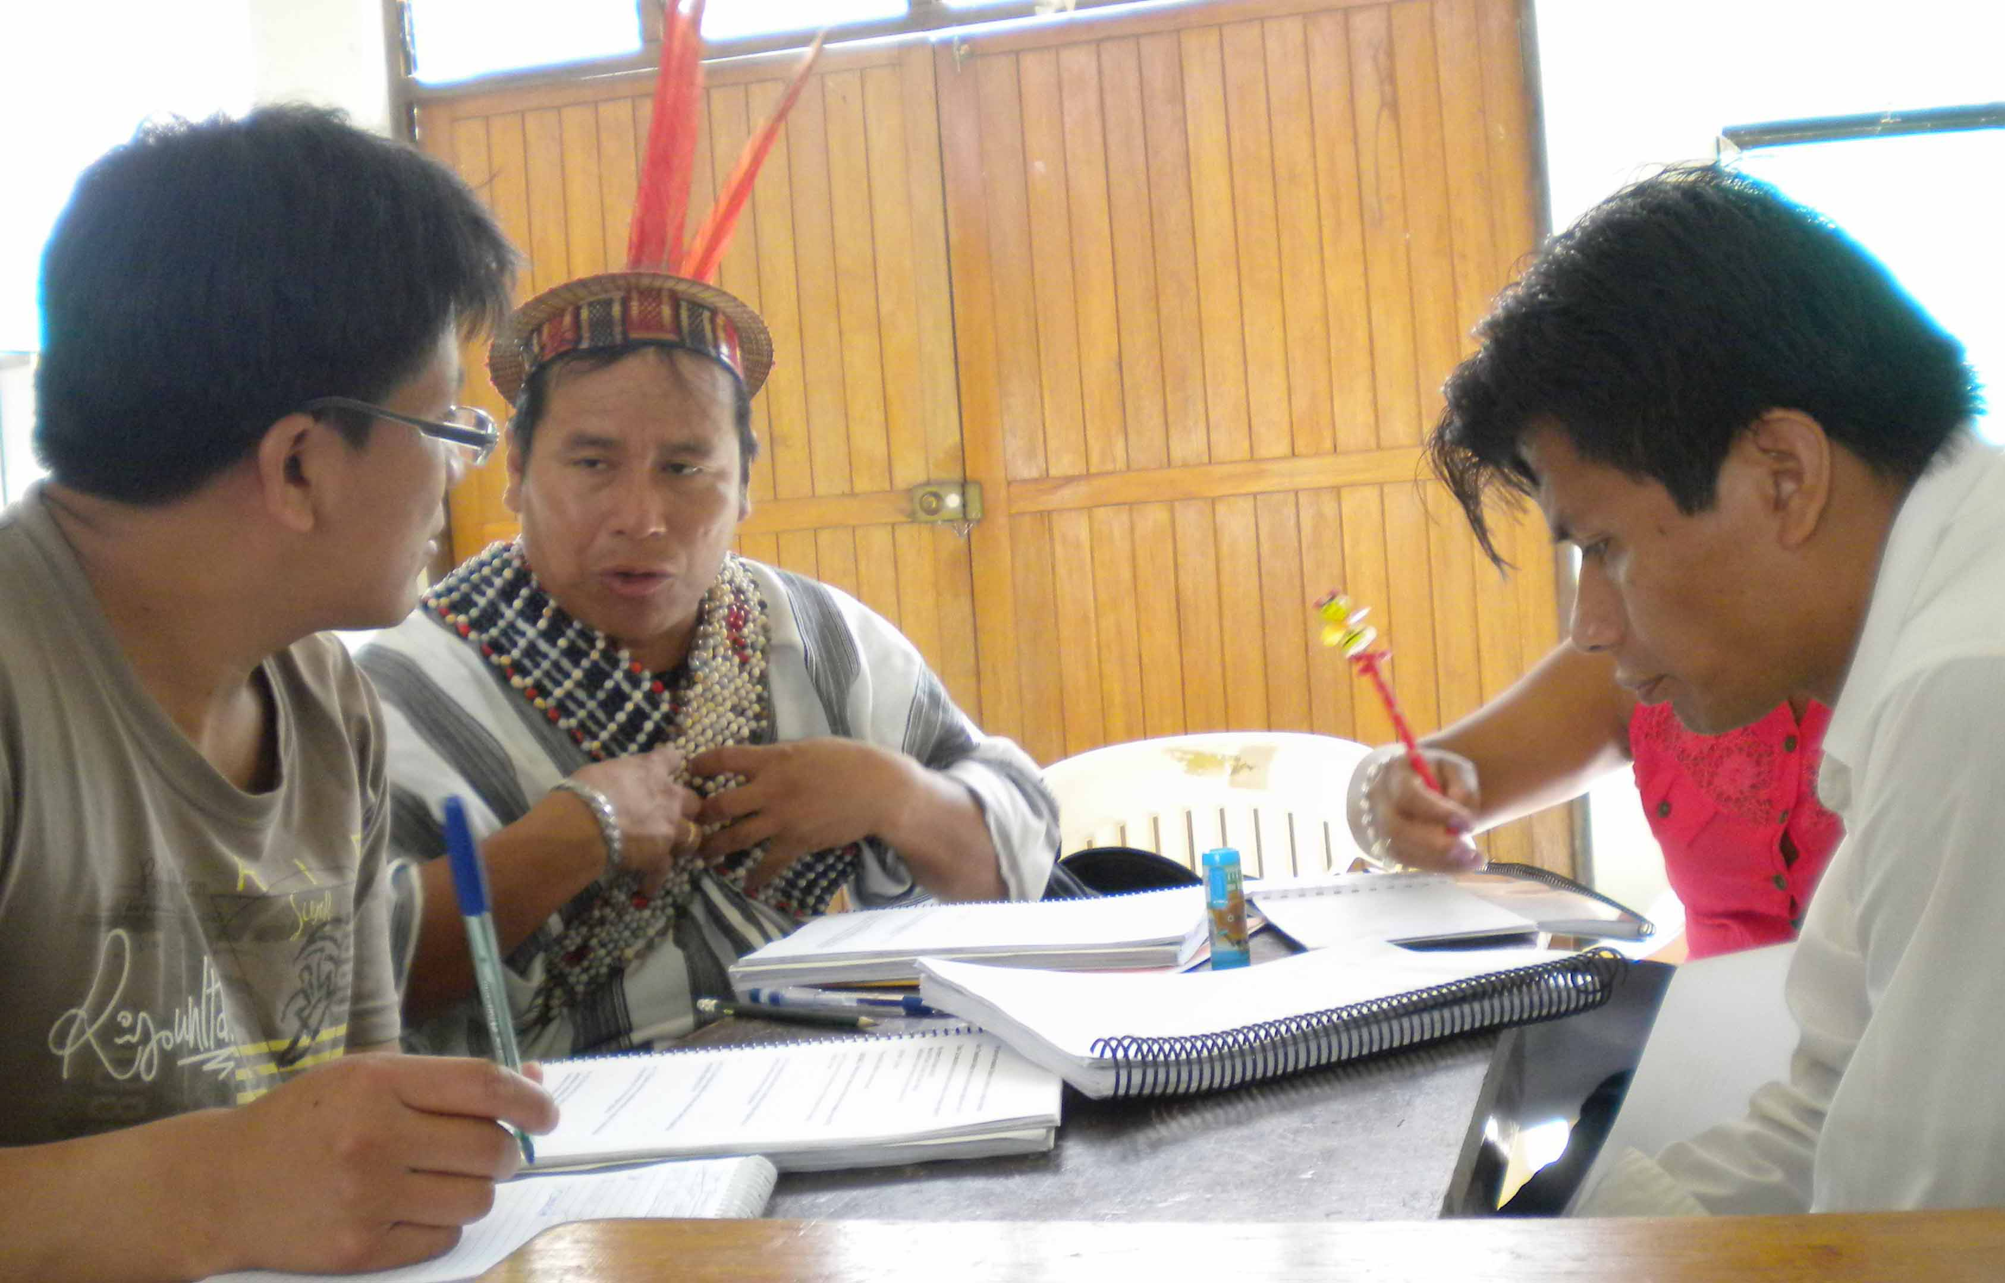

Slide 4
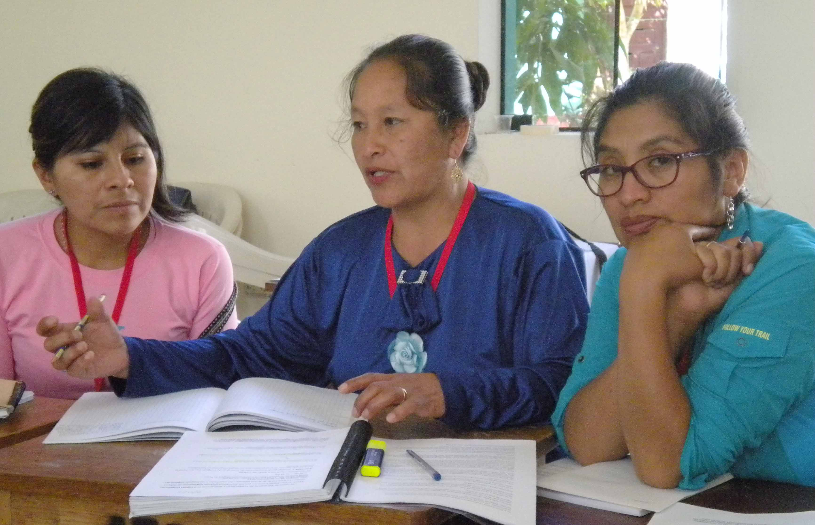

Slide 5
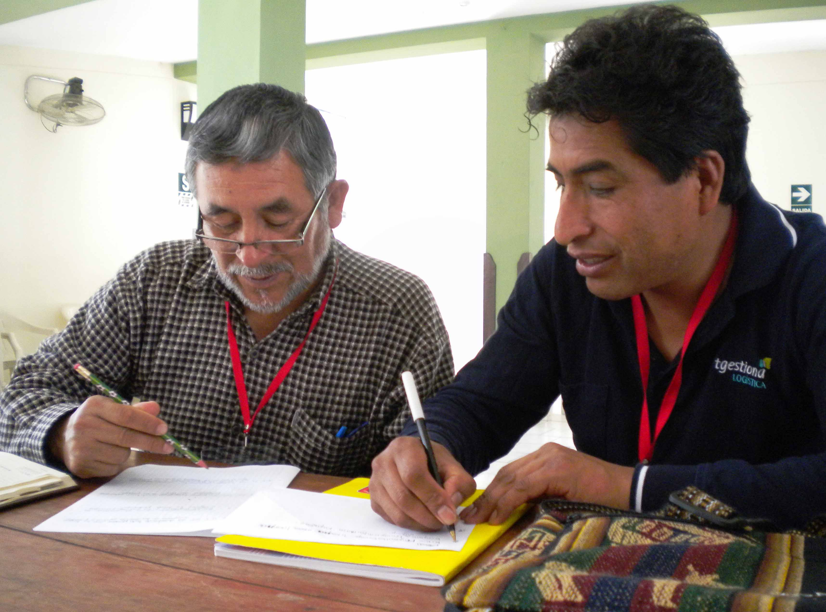

Slide 6
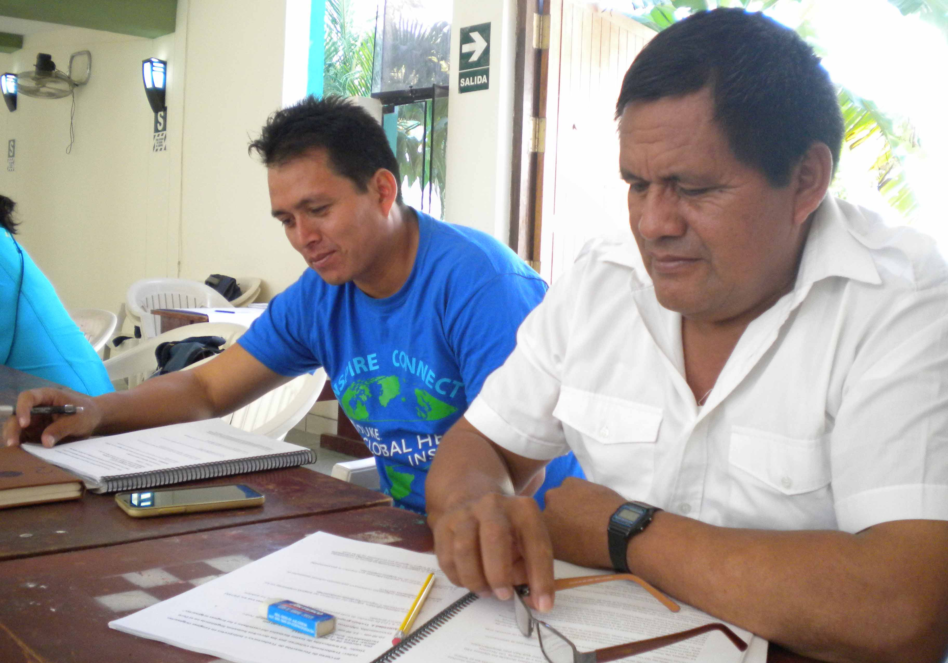

Slide 7
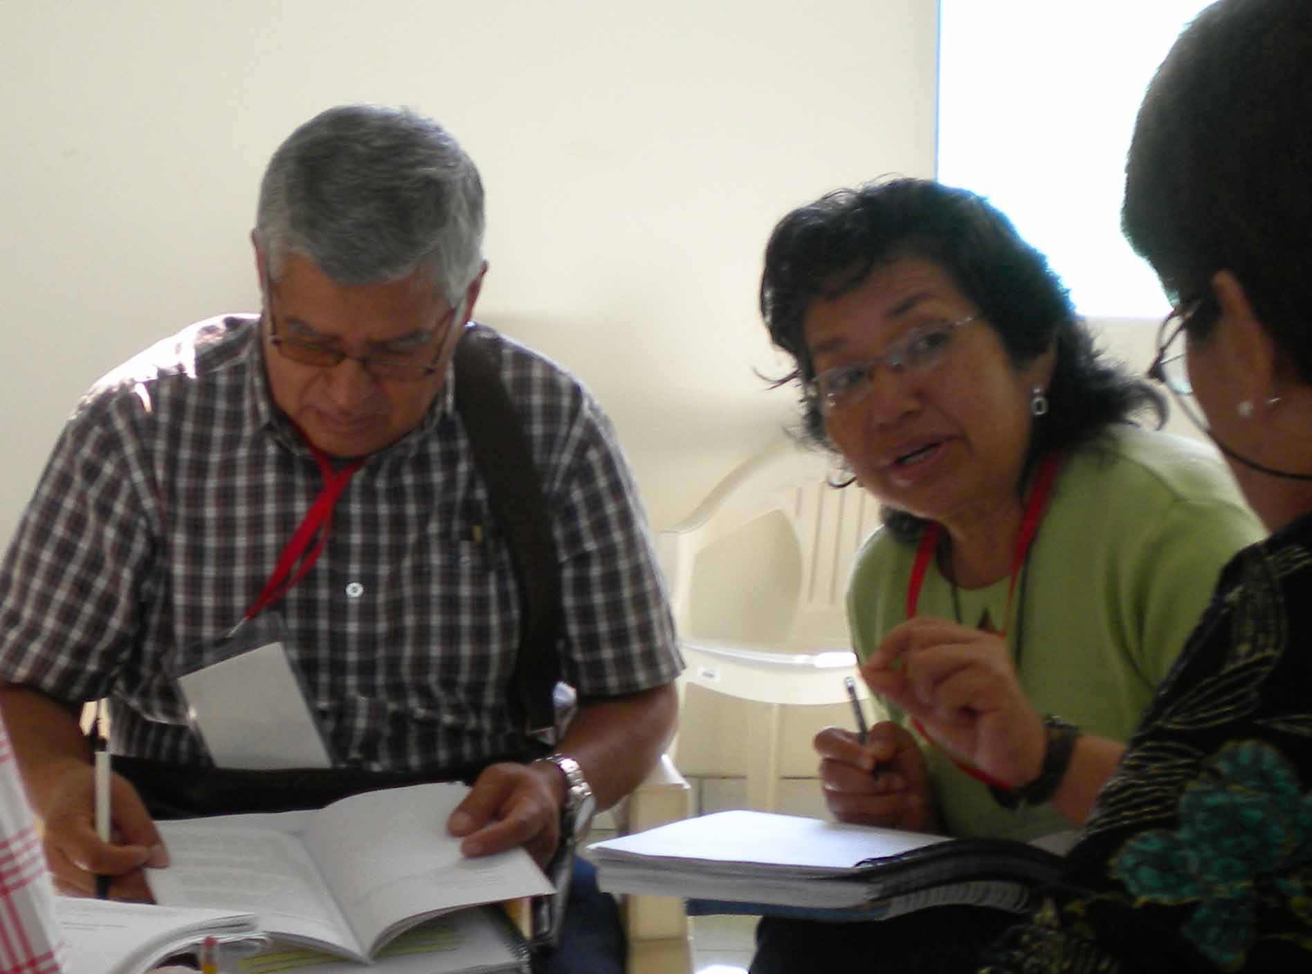

Slide 8
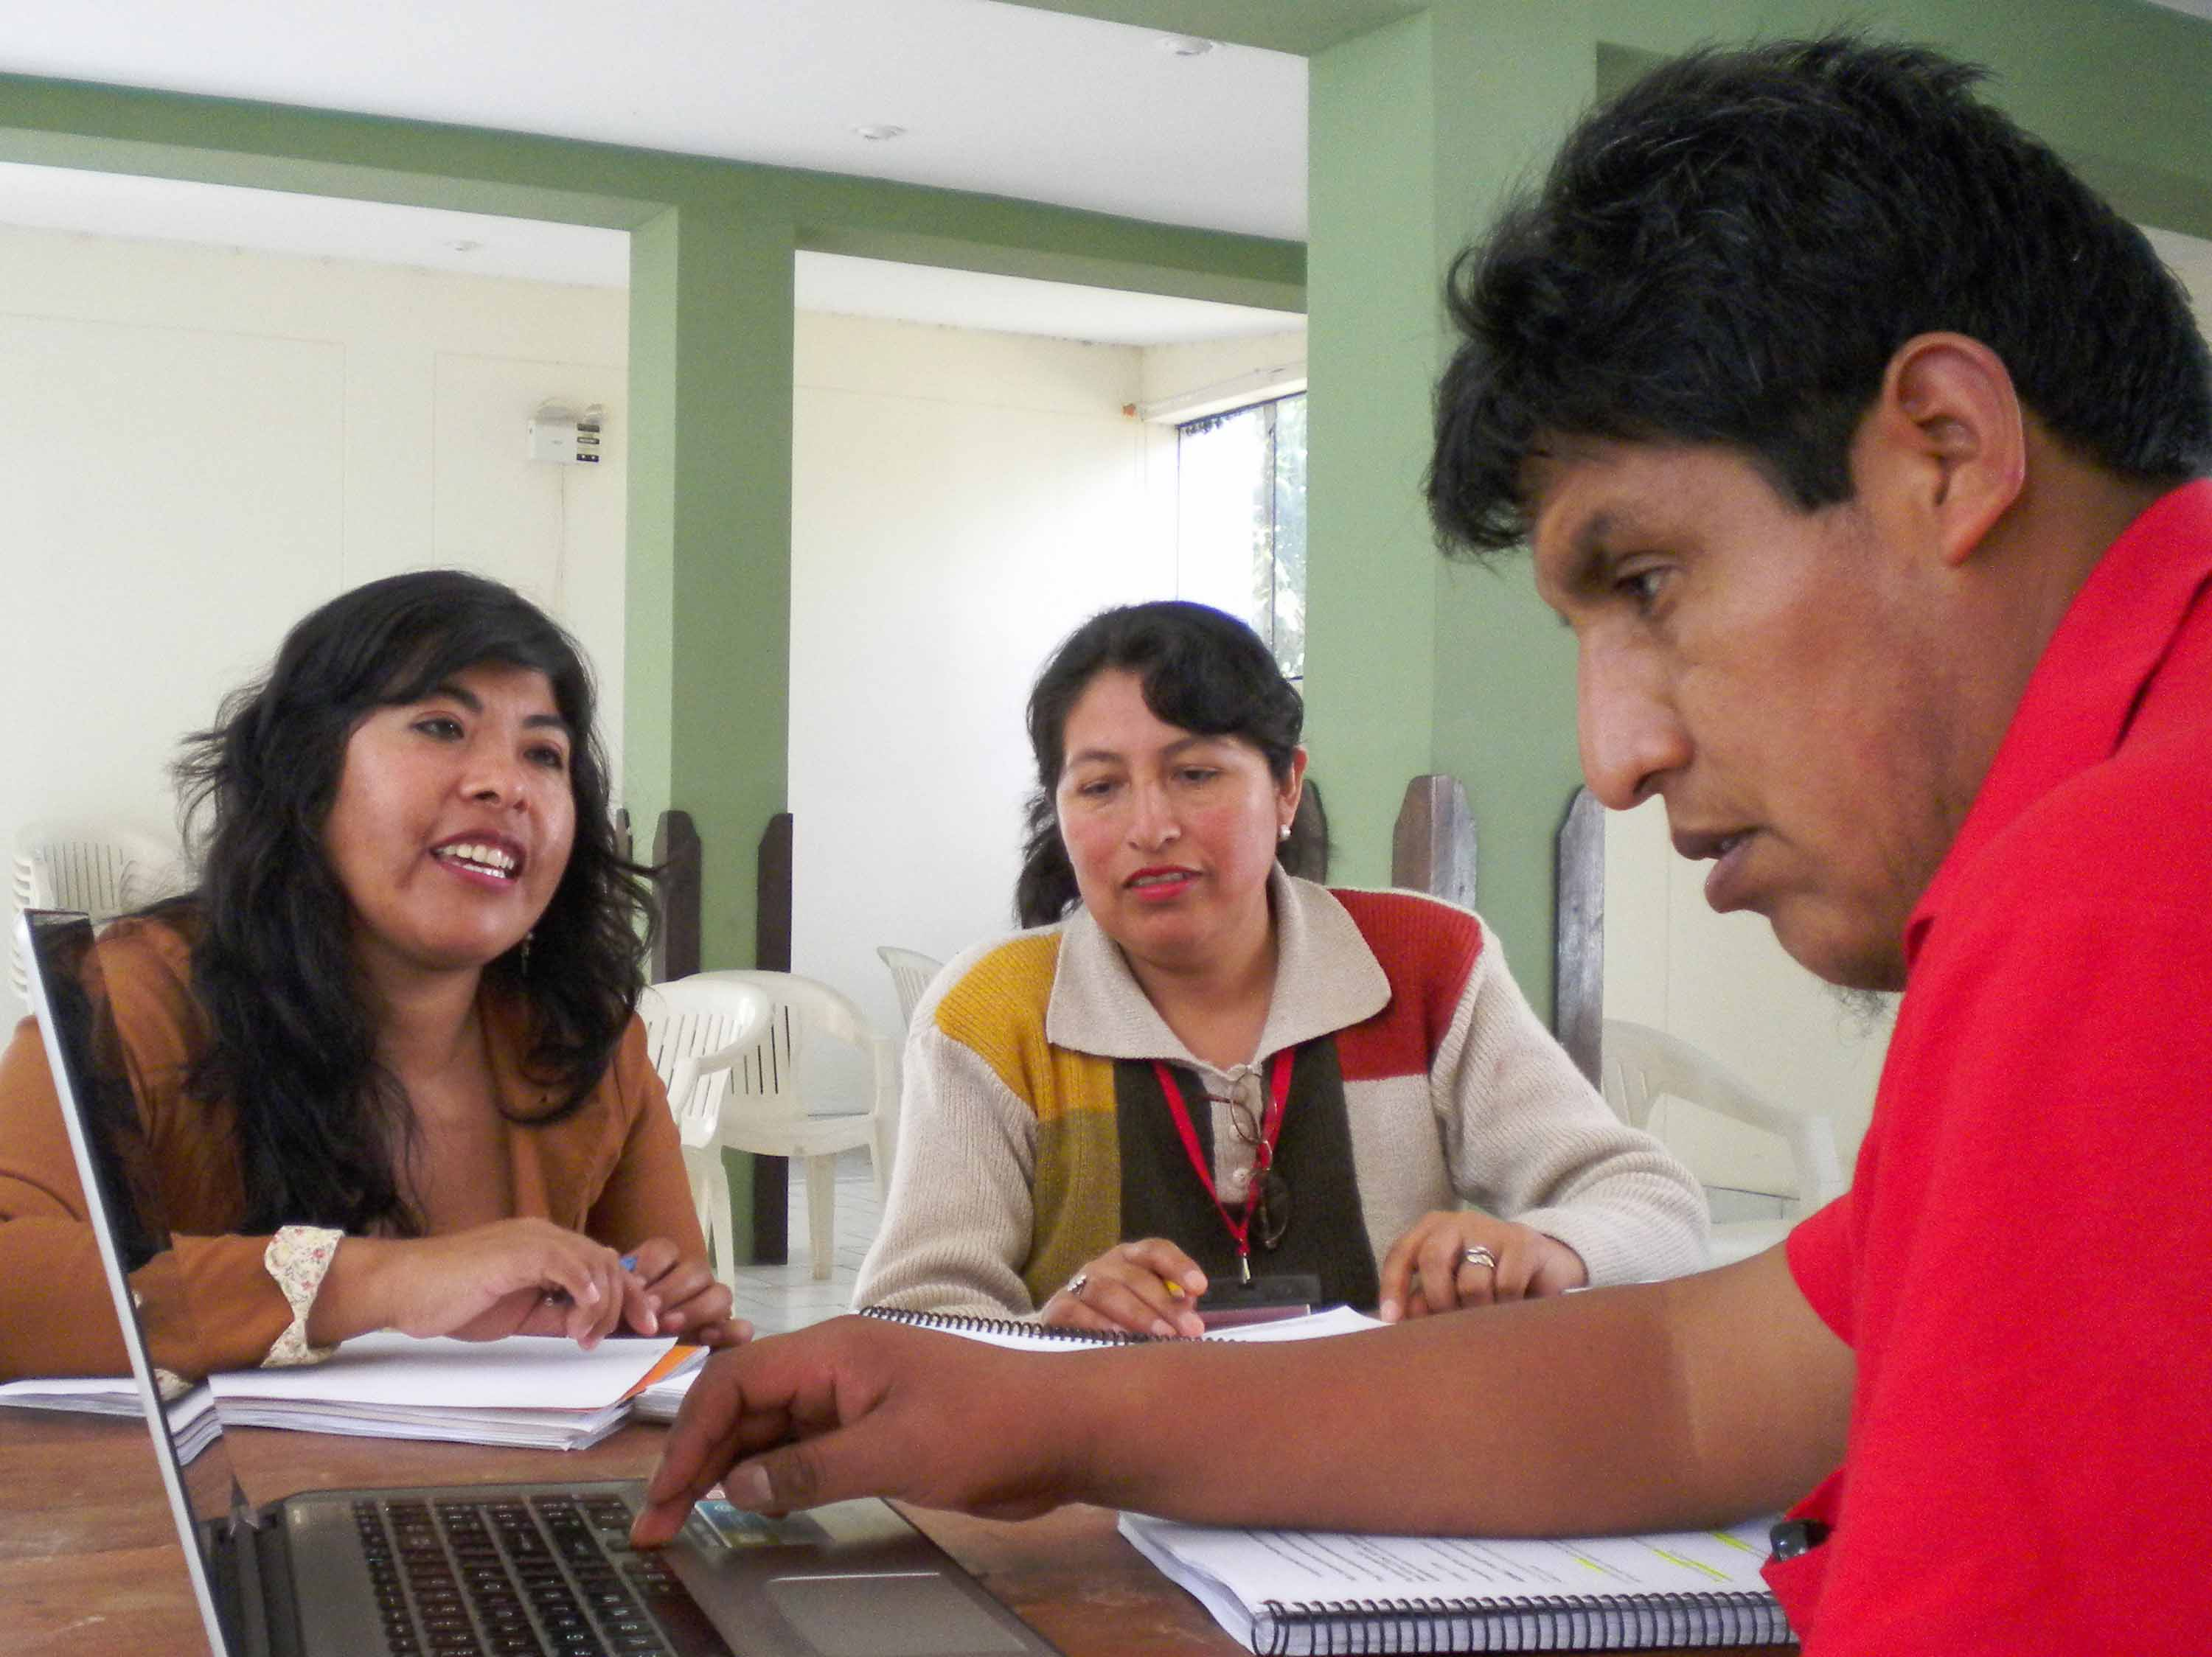

Slide 9
Framework and methodology
Theoretical framework
  Activism in translation & interpreting studies (Baker 2006, 2009; Wolf 2012; Angelelli 2012)
  Self-representation & indigenous movements (Patrick 2007; Warren & Jackson 2003; Graham 2003)
  Language ideologies (Woolard 2012; Irvine & Gal 2000; Kroskrity 2006, 2000; Siegel 2006)
Data and methodology
  Ethnographic observation; interviews, focus groups (Huaraz, Lima, Quillabamba, Ucayali).
Notes:
Interdisciplinary theoretical framework includes: (a) studies in translation and interpreting, especially in the sociology of tranlation framework, where the concept of the translator as activist –and not merely as a secondary and submissive subject– is developed.
(b) Studies of indigenous movements in Latin America, especially those devoted to indigenous representation and auto-representation. Here emphasis is put on a type of political activism marked by processes like “strategic essentialism”. Studies such as those of Patrick and Graham highlight the paramount role of language and culture as new objetcts of demand for indigenous activists.
(c) The study of language ideologies as a key concept in critical sociolinguistics. Different definitions of the notion have been developed: we depart from that of Woolard, that considers them as a set of explicit or implicit representations that interpret the relationships between language and the social. Kroskrity has emphasized the multiplicity of such representations.
We have worked nearly for 18 months making ethnographic observation of the training courses, interviewing the trainees, and conducting focus groups with them. We approached also the officers and the trainers, but the majoity of our data come from the discourses and practices of the trainees.

Slide 10
Role duality of the trainees
The state assigns the trainees a dual role: (1) translators-interpreters, (2) language rights promoters.
The trainees position themselves as “cultural ambassadors” that seek to “visibilise” and “revitalise” their languages and cultures.
This role implies a set of public activities that yield an emerging activism.
Activism goes in parallel to the state positioning.
Notes:
Dual role assigned by the state. The majority of officers emphasized the second role. They told that this guaranteed the existence of allies for the work on language rights developed by the Ministry.
Almost every trainee that we interviewed pointed up to the need of “visibilizar” their language and culture as the main motivation for applying to the course.
This activism is explicit in different spaces and types of activity: (a) language documentation, (b) mass media, (c) public services, (d) social networks such as Facebook (“digital activism”).
Therefore, there seems to be a convergence between the role of the trainees as seen by the state and as seen by themselves.

Slide 11
Convergence and professionalisation
Ambivalence of this convergence:
  It leads to a close collaboration between the state and the trainees;
  It overloads the trainees → less time for professionalisation.
A demand for greater specialisation among some of the trainees.
Notes:
However, this convergence has ambivalent cosequences in our view.
On the one side, this convergence of interests leads to a close collaboration between the state and the trainees.
But on the other side, it overloads the trainees with additional functions that make more complex the role of being translator or interpreter., which is an ambivalent role in its own, in a postcolonial context like the Peruvian one.
And it takes time from the modules that could be devoted to specialization matters.
It must be said that some of the trainees have a demand for more specialization, although they are a minority compared to those who see themselves as cultural and linguistic promoters.

Slide 12
Language conflictivity
The scholarly literature shows that the appropriation of language rights discourse by indigenous peoples may yield language conflictivity.
We have also observed this among the trainees in various ways:
Competition between dialects for status as the most appropriate to be used for standardization (Patrick 2007; Joseph 1987: dialect “partisans”)
This links to problems arising from recent offical approval of alphabets by the Ministry of Education.
Notes:
The trainees are persons who work directly with language. Therefore, we expected to find in their activity phenomena that have been described in the literature.
For example, Patrick (2007) describes an intense competence among speakers of different varieties as a result of the adoption of the language rights discourse among indigenous peoples representatives.
And that is precisely what we found in our observation: for example, among speakers of Cuzco Quechua complaining about the “concessions” they had to made to use Ayacucho or Chanka Quechua features in their written translations.
Another example is the high conflictivity between different speakers of Ashaninka (an Arawak language) towards the alphabet approved by the Ministry of Education.
It must be recalled, as Rosaleen said, that the Ministry of Education has ran in the last years a process leading to approve by consensus alphabets for different languages previously lacking them. The trainees have to work with these alphabets, but the process of reaching that consensus among the communities has not been thorough in all cases.

Slide 13
Language ideologisation
Presence of language ideologies that potentially affect translation and interpreting processes:
Purism, especially in the Andean region (Coronel-Molina 2016; Howard 2007; Niño Murcia 1997).
Ruralisation of indigenous languages as a means of cultural and linguistic differentiation (Zavala et al. 2015).
Notes:
The language ideologies that we have observed are not new. They have been already described in the sociolinguistic literature in the Andes (especially, regarding purism).
But the main aspect we want to highlight is that we can see through the activities of the trainees how these ideologies affect the central communicative goals of translation and interpreting.
For expample, ideologies of purism, which was observed especially in the Andean realm, drive the trainees to avoid borrowings from Spanish, looking for words that have been coined, for example, by the Quechua Academies, looking for archaisms, or for borrowings from other Quechua varieties, although these decisions will likely impede communication with the average speakers.
Another example: ruralisation of indigenous languages (i. e., the belief that indigenous languages are not good for urban environments, and that the “real” language is spoken by rural communities) can lead the urban trainees to position themselves unconsiously as illegitimate representatives of their peoples.

Slide 14
Purism: example
“Betsy es la comunicadora que habla mayormente en español. Yo en quechua, yo manejo más quechua popular que digamos, o sea, quechua… o quechuañol, lo que dicen, las otras personas. Rodrigo es una persona que maneja más, ya un poco más, bueno, quechua neto no existe, pero quechua un poco… bien hablado, no sé, cómo decir, adecuadamente. Y entonces, nosotros los tres hemos hecho un grupo…” (Asunta, Cuzco Quechua, interview, 26/08/15).
Notes:
This is a fragment of an interview with a Cuzco Quechua speaker that considers herself to speak a low variety of Quechua (or Quechuañol) that she wants to improve through the use of the obscure terms imposed by the Cuzco Quechua Academy, although, as a radio station communicator she has confirmed that they are not understood by average speakers.

Slide 15
Ruralisation: example
“…estamos fracturando económicamente a nuestros hermanos del campo, para que nos puedan, para poderles cumplir un derecho. Siempre digo, por eso: no subyuguemos a los intereses del Estado a nuestros hermanos del campo; más bien que el Estado se subyugue a los intereses de nuestros hermanos del campo, porque ¡favor que hacen nuestros hermanos del campo al preservar una cultura, al fomentar el uso de las lenguas!” (Mercedes, focus group, Huaraz, 20/11/2014).
Notes:
This is a fragment of an interview with an urban Quechua trainee that insistently speaks about her “siblings of the rural communities”, positioning those speakers as the “real ones” and therefore positioning herself as external to the Quechua people.

Slide 16
Linguistic and cultural essentialism
Essentialization of the links between language, culture and territory (Patrick 2007) is also present in the trainees’ discourses.
This yields notions of “authenticity” by which the trainees position themselves as representatives of the “essentials” of their culture…
… or as external to the community of “real speakers” of the indigenous language.
Notes:
This has to do with the essentialization of the links between language, culture, and territory that has also been described by the literature.
As can be seen, this essentialization yields different views of who is an authentic and legitimate speaker and who is not. Sometimes, the trainee positions him or herself as part of this group, and sometimes not, as we will see in the following examples.

Slide 17
Notions of “authenticity”: examples
“Otras personas no se interesan; son mis paisanos, pero son aculturados, y no quieren hablar idioma. En cambio a mí, sí; en mis exposiciones de la universidad yo hablaba en mi idioma; me gustaba” (Mauro, focus group, Quillabamba, 28/08/2015).
“Y hoy día he podido, este… darme cuenta con mucha nostalgia al conversar con la gente que sí es realmente de una comunidad campesina, que sí hablan su quechua, decirles: ‘Hablen, hagan esto por ustedes’…” (Mercedes, Huaraz, 20/11/2014).
Notes:
Mauro, a matsiguenka speaker, clearly positions himself as part of the “authentic” group.
Mercedes does not.
As we can imagine, this positioning can lead to different hierarchies between these new professionals and the average speakers they are supposed to serve.
As we can see also, the discourses of essencialization can lead to hierarchies among the indigenous peoples themselves, and not only with reference to the wider, non-indigenous, society.

Slide 18
Pending questions
How do the emerging forms of activism relate to the different linguistic, ethnic, and professional profiles of the trainees?
How do their “linguistic biographies” relate to their decision to do the training course?
How have their “linguistic biographies” shaped their current ideological stances related to language and culture?
Notes:
A path for working on this is to correlate the information about the antecedents of the trainees (for example, what kind of institution supports their application) with the forms of activism and ideological stances we have observed.
A more fine-grained analysis of the biographical interviews we have conducted with some of the trainees would help to answer these final questions.

Slide 19
Preliminary conclusions
Linguistic and cultural activism seems to be emerging among the trainees.
This activism is different from that described by Translation Studies and by scholarship on indigenous movements in Latin America in its focus on the “language-culture nexus”.
Theoretical and empirical advances in the study of language ideologies can shed light:
  On how this emerging activism is evolving;
  On aspects of the translator-interpreter discourses that run counter to the intercultural values that underpin the training.
Notes:
Some final remarks.
This activism we are describing is different in that it highlights cultural and linguistic aspects of indigenous peoples.
As language is central to the activities, practices, and discourses of the trainees, it was likely that the study of language ideologies could help us to illuminate some of the evolving processes.
Crucially, these studies can help illuminate some aspects of these practices that are pitfalls for communication and, specially, for intercultural communication, which is one of the main goals of the traiing initiative.

